Slide 1

DEPARTMENT OF COMPUTER SCIENCE AND ENGINEERING
Professional Training - 1
ONLINE JEWELLERY STORE
PROJECT STUDENT GUIDE
M.V. Harsha Uday, 42111546 Dr.Srideivanai Nagarajan, M.C.A., M.Phil., Ph.D Associate Professor, CSE

Slide 2
AGENDA
Certificate
Introduction
Abstract
Objective
System Architecture / Ideation Map
Module Implementation
Results and Discussions
Conclusion
References

Slide 3

COURSE CERTIFICATE

Slide 4
INTRODUCTION
Online Jewellery Store Overview
Purpose: Provide a convenient and luxurious online shopping experience for jewellery.
Key Objectives:
Customer Convenience: Easy browsing and purchasing of various jewellery items.
Automation and Efficiency: Streamlined inventory management and order processing.
Inventory Optimization: Real-time stock tracking to prevent overstock or stockouts.
Enhanced User Experience: User-friendly design with intuitive navigation and advanced search filters.
Secure Payments: Multiple safe payment options with encrypted transactions.
Efficient Order Management: Automated order processing with real-time tracking updates for customers.
Comprehensive Admin Panel: Full control over product management, sales analysis, and promotional activities.

Slide 5
INTRODUCTION
Key Features
Product Catalog: Visually appealing, easily navigable categories for jewellery items.
User Authentication: Secure account creation and management for customers.
Advanced Search and Filters: Refine searches based on various criteria.
Shopping Cart and Wishlist: Save items for later or prepare for immediate purchase.
Secure Checkout: Multiple payment options with automatic tax and shipping calculations.
Order Tracking: Real-time tracking of delivery status.
Customer Reviews and Ratings: Access to feedback from other buyers.
Return and Exchange Policy: Integrated process for returns based on predefined policies.
Promotions and Discounts: Special offers and voucher codes automatically applied at checkout.

Slide 6
INTRODUCTION
Technology Stack
Frontend: Built with HTML5, CSS3, JavaScript, and frameworks like React or Vue.js.
Backend: Powered by Java, with REST APIs for smooth communication.

Slide 7
ABSTRACT
The objective of this project is to create an *Online Jewellery Store* that optimizes customer experience and business operations through automation. It aims to streamline essential tasks like inventory management and order processing, ensuring seamless shopping for users and efficient operations for administrators.
Advantages of the Proposed Work
Automation and Efficiency : The system automates critical processes such as inventory management and order processing, significantly reducing manual intervention. This ensures real-time accuracy, enhances operational efficiency, and minimizes human errors for smoother business operations.

Slide 8
ABSTRACT
User Experience and Security : A smooth, intuitive user interface allows customers to easily browse and purchase products, improving convenience and satisfaction. Integrated secure payment gateways safeguard sensitive customer data while offering multiple payment options to foster trust in transactions.
Inventory and Order Management : Real-time tracking of inventory ensures accurate stock levels, reducing the risk of overselling and enhancing customer confidence. The platform handles orders efficiently, providing instant confirmations and real-time tracking to improve transparency and customer satisfaction.
Scalability and Growth : The system is designed to scale with business growth, effectively accommodating both small boutiques and larger enterprises. Its centralized database supports accurate data management and decision-making, eliminating manual records and meeting operational needs as the business expands.

Slide 9
OBJECTIVE
Main Objectives of the Online Jewellery Store :
Enhance Customer Shopping Experience : Provide a seamless and user-friendly platform for browsing and purchasing jewellery.
Automate Business Operations : Streamline key processes like inventory management and order fulfillment to improve efficiency and reduce manual work.
Ensure Secure Transactions : Implement secure payment methods to protect customer data and build trust.
Optimize Inventory Management : Maintain real-time tracking of stock to ensure product availability and prevent overselling.
Support Scalability : Create a flexible system that can grow with the business, accommodating expanding operations.

Slide 10
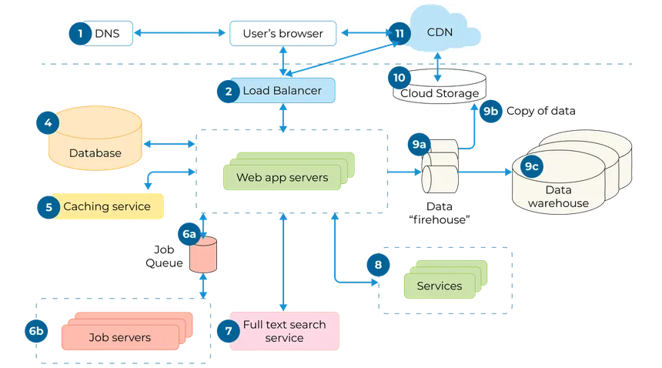
SYSTEM ARCHITECTURE / IDEATION MAP

Slide 11

MODULE IMPLEMENTATION
Home page

Slide 12
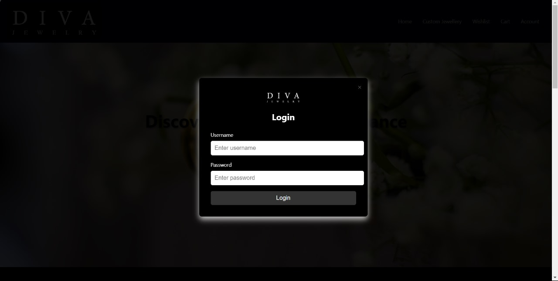
MODULE IMPLEMENTATION
Login popup

Slide 13

MODULE IMPLEMENTATION
Shop page

Slide 14
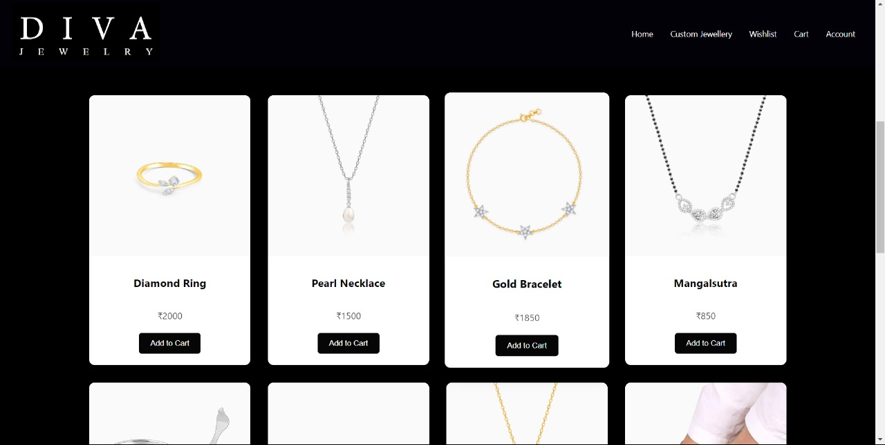
MODULE IMPLEMENTATION
Product page

Slide 15
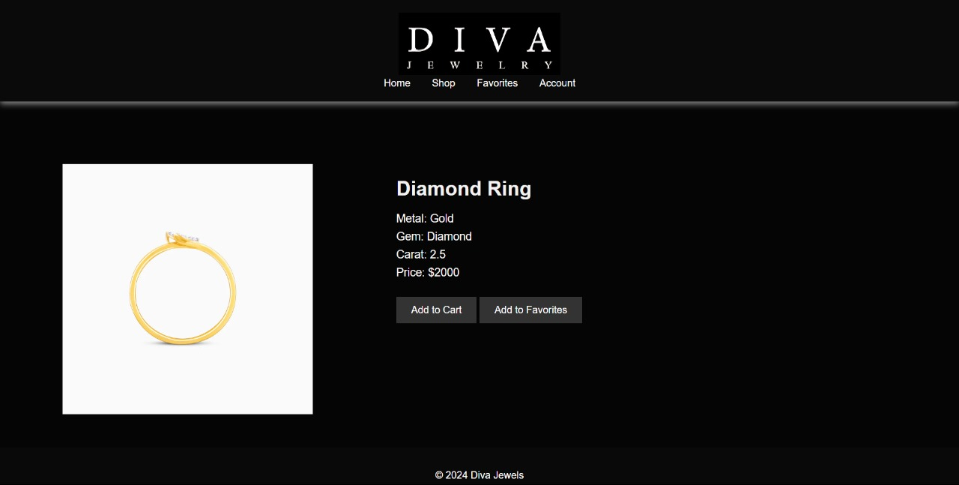
MODULE IMPLEMENTATION
Product sub page

Slide 16
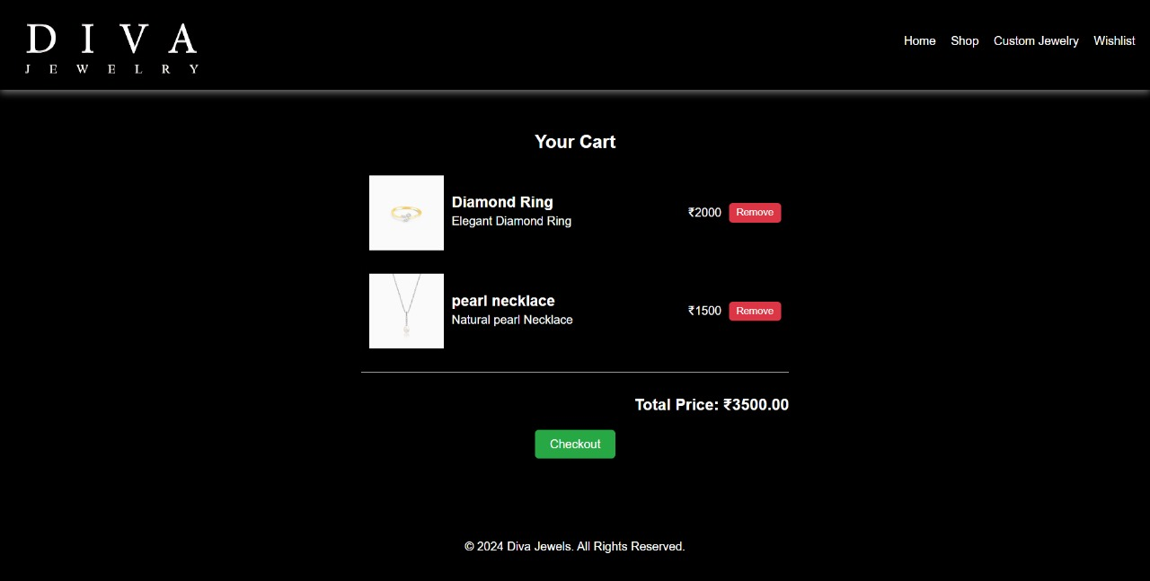
MODULE IMPLEMENTATION
Cart page

Slide 17
RESULTS AND DISCUSSIONS
Result
After launching Diva jewellery, we observed significant engagement and interest in our jewelry collection. Our website analytics indicated a steady increase in traffic, with a notable rise in unique visitors and returning customers.
Customer feedback has been overwhelmingly positive, highlighting the quality of our products, ease of navigation on the site, and the responsive nature of our customer service. We successfully introduced a variety of promotional campaigns, leading to a substantial increase in sales during key periods, such as holiday seasons and special events.
The establishment of an online jewelry store has yielded promising outcomes across several key areas. Firstly, customer engagement has markedly increased due to effective social media and online marketing strategies, resulting in enhanced visibility and higher traffic to the website. Secondly, the store's diverse product range has successfully attracted a broader audience, catering to various tastes and preferences. Seasonal and trending collections have been particularly well-received, contributing to increased sales.

Slide 18
RESULTS AND DISCUSSIONS
Discussion
The discussion highlights several key factors contributing to the success of the online jewellery store. Several key factors contribute to the success of the online jewellery store.
First, offering a diverse range of products, including handmade and ethically sourced items, aligns with the growing consumer preference for sustainable and unique jewellery. This not only caters to niche markets but also promotes brand loyalty. Moreover, strong customer service, encompassing easy return policies and responsive support, fosters trust among buyers, encouraging repeat purchases..
The technical specifications outlined in the document ensure that the store is built on a solid foundation, with the necessary infrastructure to support its operations. The marketing and promotion strategies outlined in the document help to drive traffic and sales to the store.

Slide 19
CONCLUSION
In conclusion, the establishment of an online jewelry store offers a valuable platform for reaching customers in a convenient and accessible manner. By prioritizing a visually appealing and easy-to-navigate website, the store can create an engaging shopping experience that resonates with users. Focusing on a diverse range of jewelry products tailored to various tastes will help attract a broad audience and meet the needs of different customers.
Furthermore, leveraging social media and online marketing can enhance customer engagement and build a community around the brand. Listening to customer feedback and adapting to their preferences will be crucial for maintaining relevance in the ever- changing jewelry market. Ultimately, the success of the online jewelry store will depend on its ability to provide an enjoyable and memorable shopping experience, fostering customer loyalty and encouraging repeat visits.

Slide 20
REFERENCES
Brown, S. (2020). E-commerce Strategies for Luxury Goods: Case Study of the Jewelry Industry. Journal of Retail & Consumer Services, 55, 102099. https://doi.org/10.1016/j.jretconser.2020.102099
Fischer, M., & Schneider, K. (2019). Customer Experience in Online Jewelry Stores: Key Design Principles. E-Commerce Times. Retrieved from https://www.ecommercetimes.com/article/customer-experience-in-online- jewelrystores.html
Ghosh, R. (2023). Trends in Online Jewelry Shopping Post-Pandemic: What Retailers Should Know. Forbes. Retrieved from https://www.forbes.com/trendsonline-jewelry
Kahn, R., & Zhao, L. (2022). Search Engine Optimization and Branding for Online
Retailers: A Comprehensive Guide. Wiley Publishing.
Smith, A. (2021). Developing an Online Jewelry Store: Key Technology Considerations. Shopify Blog. Retrieved from https://www.shopify.com/blog/online-jewelry-store

Slide 21
THANK YOU
We thank God, Our Department, Guide, Panel Members, Supportive Professors and all Technical and non Technical staff who helped us in our Project.

